Slide 1

GENERAL
ASSET INVESTMENTS
Investment Cycle Planning
GA-DSIF2: Group 6 – Project 2
AMES Housing
Group 6: John, Simon, Siti, Zheqin

Slide 2
Agenda
Executive Summary & Problem Statement
Project Scope
House Price Prediction Approach & Model
House Value Determinants
Investment Recommendations & Next Steps
Notes:
: data science model & business implications
develop several models and looked for consistently important factors, develop business case on this
: How we did feature engineering: Drop (high missing values, correlated with other features), impute, grouped low frequency categories, delete remaining rows

Slide 3



Executive Summary & Problem Statement
Problem
Statement
Business implications
Identify actionable renovation levers that increase value in short-term with appropriate investment & risk
Develop investment plan comprising funding needs and return expectations for General Asset Investments
Recommendation
Invest in real estate with renovation upside in:
Overall house quality
Exterior quality
Kitchen quality
46 suitable properties identified over investment period of 4 years that can be remodeled with 1.7m USD profit on an investment of 4.6m USD for a 37% return with very limited cost of capital
Develop predictive model forecasting house-selling price
Data-driven identification of high-return investment opportunities through remodeling / renovation
Notes:
DESCRIPTIVE ABSTRACT: Data set contains information from the Ames Assessor’s Office used in computing assessed values for individual residential properties sold in Ames, IA from 2006 to 2010.

Slide 4
Agenda
☑
Executive Summary & Problem Statement
Project Scope
House Price Prediction Approach & Model
House Value Determinants
Investment Recommendations & Next Steps
Notes:
: data science model & business implications
develop several models and looked for consistently important factors, develop business case on this
: How we did feature engineering: Drop (high missing values, correlated with other features), impute, grouped low frequency categories, delete remaining rows

Slide 5

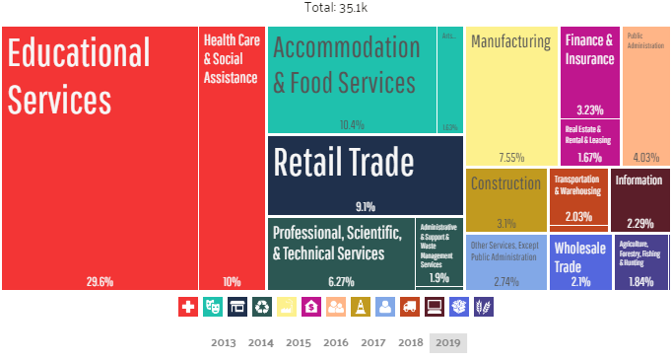
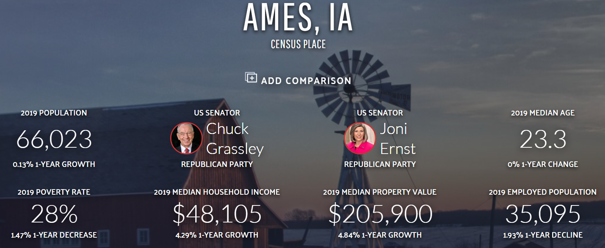
Project Scope
Demographics
GDP drivers
Very young population
Comparably low household incomes
Strong dynamic growth indicates interesting investment opportunities
Education is the key anchor of the local economy
Retrieved from: https://datausa.io/profile/geo/ames-ia

Slide 6
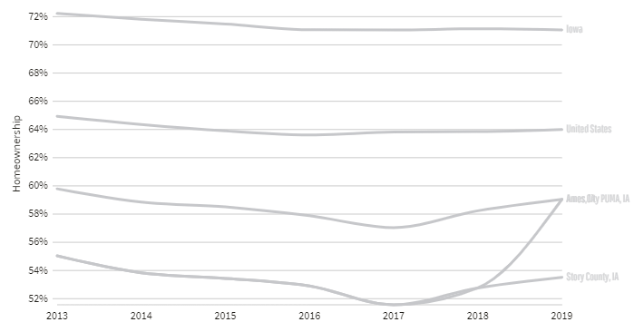
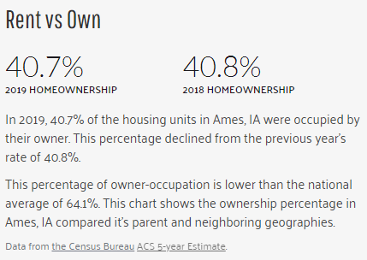
Project Scope
House ownership drivers
Ames is a college town and the Iowa State University is the largest employer
Retrieved from: https://datausa.io/profile/geo/ames-ia
Point to consider:
Features that appeal for investment property (student rentals) may be dissimilar to owner-occupied property
Notes:
Train dataset 2,051 lines (8.5%)

Slide 7
Agenda
☑
Executive Summary & Problem Statement
Project Scope
☑
House Price Prediction Approach & Model
House Value Determinants
Investment Recommendations & Next Steps
Notes:
: data science model & business implications
develop several models and looked for consistently important factors, develop business case on this
: How we did feature engineering: Drop (high missing values, correlated with other features), impute, grouped low frequency categories, delete remaining rows

Slide 8
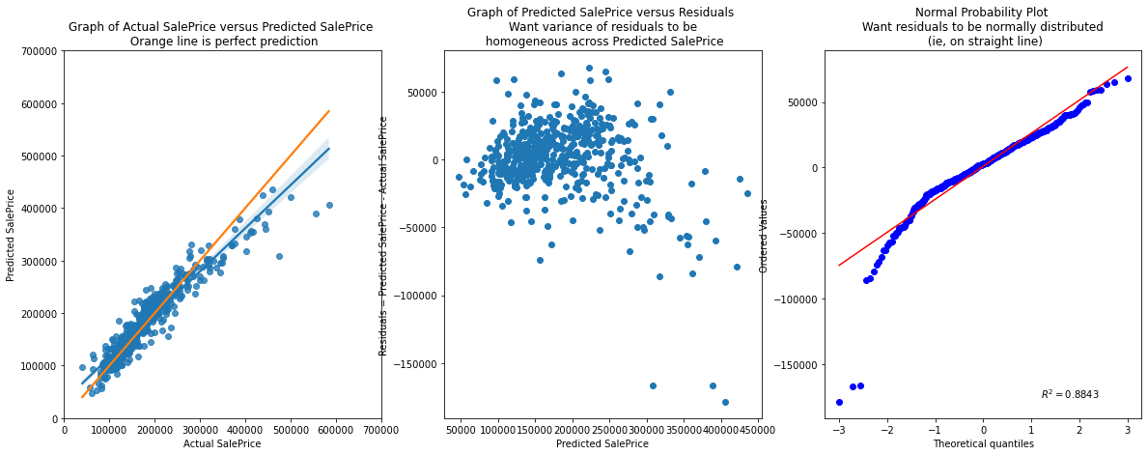
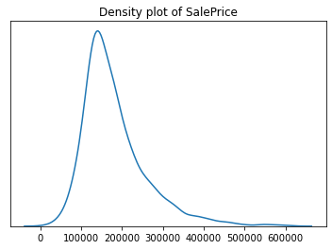
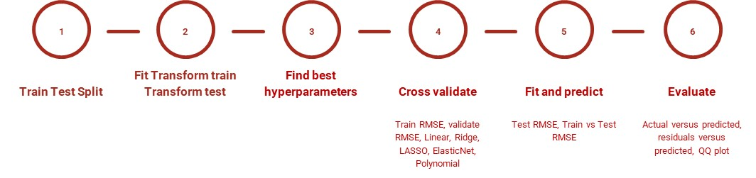
Approach & Model
Approach & model
Findings
Significant effort invested to increase quality of dataset through extensive feature engineering, inclusion of domain knowledge and comprehensive model tuning
Data consolidation
Data imputation
Based on categories with low frequency, multicollinearity analysis, missing data
Based on domain knowledge and other features
Developed model seems fit to predict house price value drivers with significant confidence
Feature engineering
Transformation and encoding of ordinal features based on domain knowledge
Distribution of house values skewed towards properties on the lower end
Demand for medium-value properties visible allowing exploration of remodeling / renovation opportunities

Slide 9
Agenda
☑
Executive Summary & Problem Statement
Project Scope
☑
House Price Prediction Approach & Model
☑
House Value Determinants
Investment Recommendations & Next Steps
Notes:
: data science model & business implications
develop several models and looked for consistently important factors, develop business case on this
: How we did feature engineering: Drop (high missing values, correlated with other features), impute, grouped low frequency categories, delete remaining rows

Slide 10
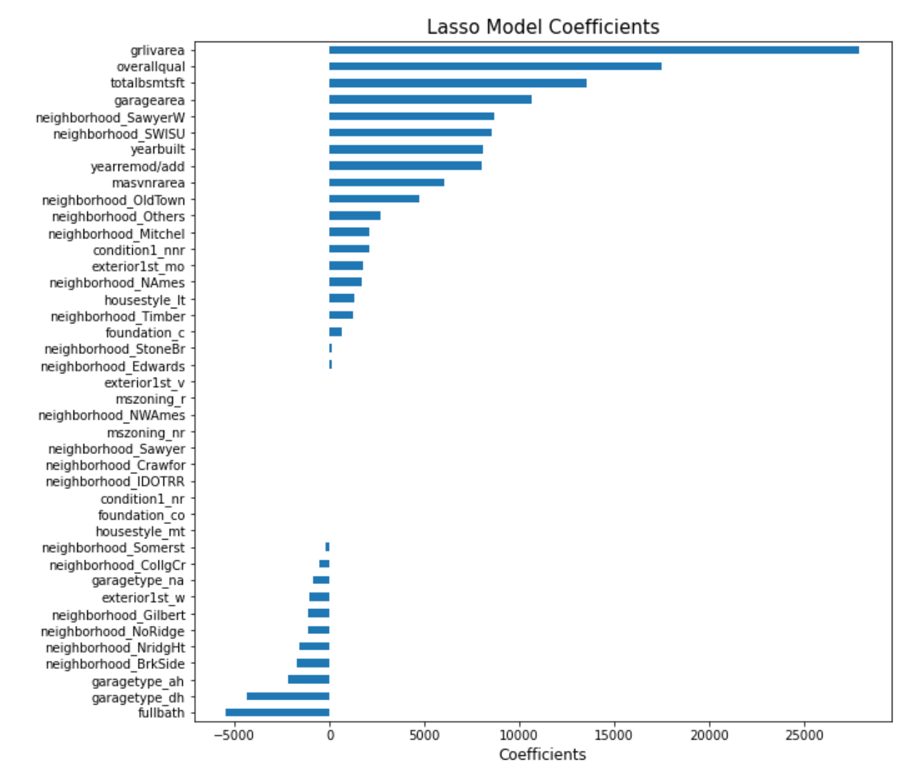
House Value Determinants
Value driver assessment
Key findings
Model
I
II
III
IV
Fixed
Living Area
Neighborhood
Northbridge
Stonebrook
1st Floor Size
Garage Size
[…]
Actionable
Ensemble method to identify key predictors identified common features with strong significance to determine house prices
Actionable ones are “Overall Quality”, “Exterior Quality” and “Kitchen Quality”
Overall Quality
Exterior Quality
Focus areas
Kitchen Quality
Roof Material
[…]

Slide 11
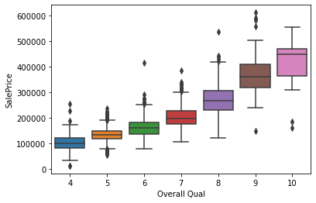
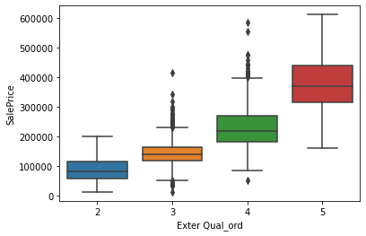
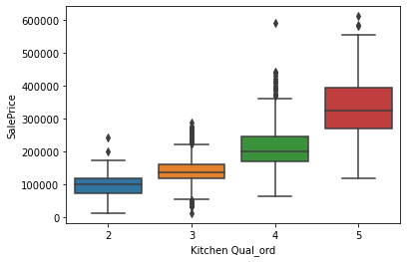
House Value Determinants
Investment options
Business case
Improvement value per quality level
Improvement levers
Improvement levels & investment
Acquisition of properties with renovation potential in key categories promising significant returns
Fast turn-around of renovation activities reduces cost-of-capital, however significant capital outlay required
46 suitable properties identified in baseline of 2051 properties
Windows
Shutter
Porch
Paint
[…]
Overall quality
~17500 USD
+3
~30000 USD
Exterior quality
Stone Veneer
Garage Door
Front Door
+2
~6300 USD
~6000 USD
Kitchen quality
Minor kitchen remodeling
+2
~5700 USD
~4000 USD

Slide 12
Agenda
☑
Executive Summary & Problem Statement
Project Scope
☑
House Price Prediction Approach & Model
☑
House Value Determinants
☑
Investment Recommendations & Next Steps
Notes:
: data science model & business implications
develop several models and looked for consistently important factors, develop business case on this
: How we did feature engineering: Drop (high missing values, correlated with other features), impute, grouped low frequency categories, delete remaining rows

Slide 13
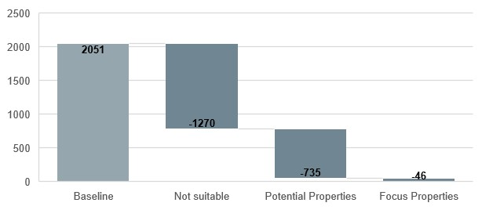
Recommendation & next steps
Investment opportunity
Risks
Recommendation / Next steps
Refreshing of model with more recent data required to consider effect of external anomalies (e.g. Financial Crisis 2008)
Include additional factors in line with best practices in real estate domain knowledge (e.g. distance to transportation)
Secondary effects of investment opportunity profitability erosion due to inflation of up-scale properties
Investment opportunity
Recommendation to allocate funds to pursue real estate remodeling opportunities as they emerge (~ 1.2m USD annually for AMES region)
46 clear investment opportunities (out of 2051 houses) identified over 4 year period matching renovation criteria with conservative assumptions
~37% margin expected after accounting for renovation cost
Investment of 4.6m USD for return of 6.3m USD (after cost)
Scaling to other geographies possible but requiring validation
Set-up real estate team
Scale-up data science resources to further develop model, explore scaling to other geographies and validate potential properties

